Slide 1
Particle filter methods for hidden state models
MATRIX workshop on Parameter Identifiability in Mathematical Biology
September 2024
Michael Plank

Slide 2
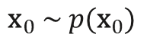
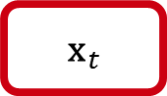
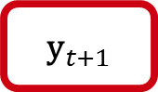
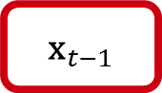
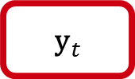
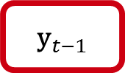
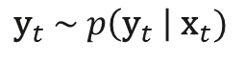
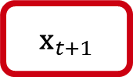
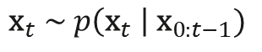
Hidden state models
Aka hidden Markov models (HMM), partial observed Markov processes (POMP), state space models (SSM)
$${\text{x}}_{t−1}$$
$${\text{x}}_{t}$$
$${\text{x}}_{t+1}$$
Hidden states
Observations
$${\text{y}}_{t−1}$$
$${\text{y}}_{t}$$
$${\text{y}}_{t+1}$$
Initial distribution
$${\text{x}}_{0} \sim p({\text{x}}_{0})$$
Dynamic model
$${\text{x}}_{t} \sim p\left({\text{x}}_{t} \right| {\text{x}}_{0:t−1})$$
- process noise
Observation model
$${\text{y}}_{t} \sim p\left({\text{y}}_{t} \right| {\text{x}}_{t})$$
- measurement noise

Slide 3
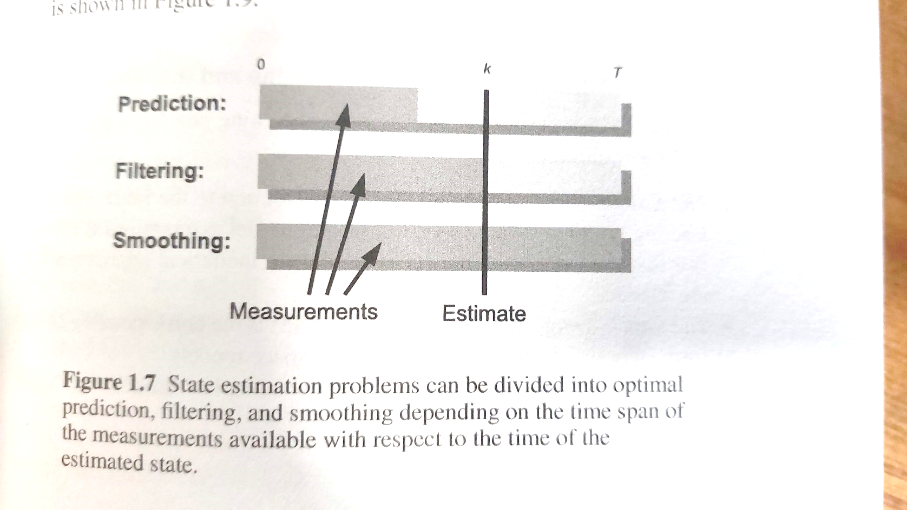
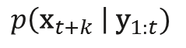
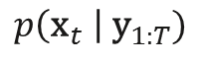
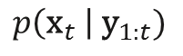
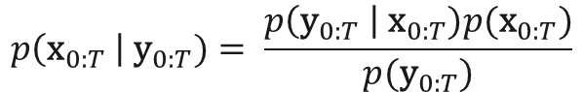
General problem
Infer distribution of hidden states ${\text{x}}_{t}$ from observed data ${\text{y}}_{t}$
$$p\left({\text{x}}_{0:T} \right| {\text{y}}_{0:T})= \frac{p\left({\text{y}}_{0:T} \right| {\text{x}}_{0:T})p({\text{x}}_{0:T})}{p({\text{y}}_{0:T})}$$
likelihood × prior
=
normalisation const
Full joint distribution of hidden states can be computationally intractable, so sometimes interested in particular marginal distributions:
$$p\left({\text{x}}_{t} \right| {\text{y}}_{1:t})$$
Filtering distribution – current state given previous & current measurement
$$p\left({\text{x}}_{t+k} \right| {\text{y}}_{1:t})$$
Prediction distribution – future state given previous & current measurement
$$p\left({\text{x}}_{t} \right| {\text{y}}_{1:T})$$
Smoothing distribution – state given previous & future measurements
Särkkä, Bayesian Filtering and Smoothing

Slide 4
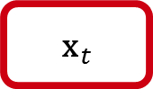
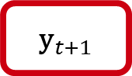
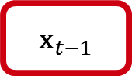
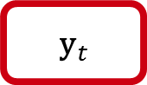
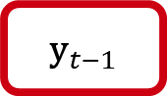
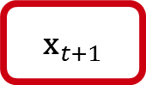
Methods for estimating hidden states
$${\text{x}}_{t−1}$$
$${\text{x}}_{t}$$
$${\text{x}}_{t+1}$$
Hidden states
Observations
$${\text{y}}_{t−1}$$
$${\text{y}}_{t}$$
$${\text{y}}_{t+1}$$
Efficient methods are available in special cases, e.g. Kalman filter, if the dynamic model and measurement model are both linear with Gaussian noise.
Focus here on: models that are nonlinear and/or non-Gaussian
methods to sample from (joint/marginal) posterior distribution of hidden states

Slide 5
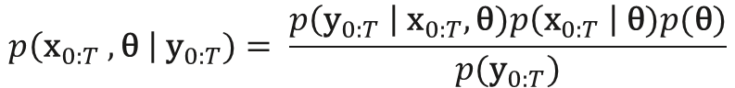
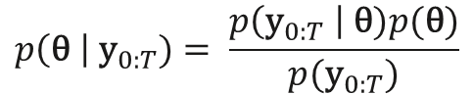
Parameter estimation
May also want to estimate unknown model parameters $\text{θ}$, either jointly with hidden states ${\text{x}}_{0:T}$
$$p\left({\text{x}}_{0:T} , \text{θ} \right| {\text{y}}_{0:T})= \frac{p\left({\text{y}}_{0:T} \right| {\text{x}}_{0:T}, \text{θ})p\left({\text{x}}_{0:T} \right| \text{θ})p(\text{θ})}{p({\text{y}}_{0:T})}$$
or marginalised over hidden states
$$p\left(\text{θ} \right| {\text{y}}_{0:T})= \frac{p\left({\text{y}}_{0:T} \right| \text{θ})p(\text{θ})}{p({\text{y}}_{0:T})}$$

Slide 6
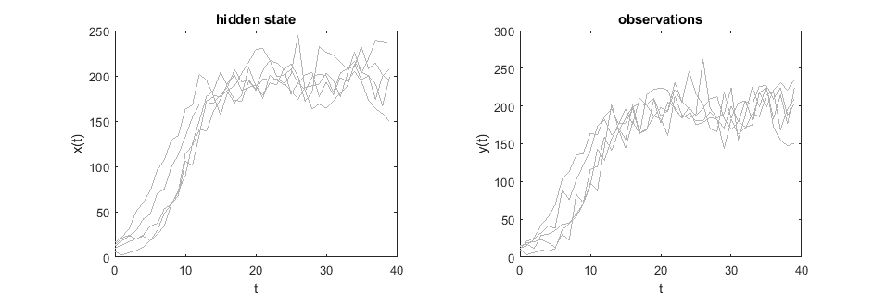
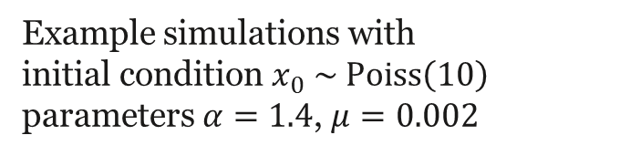
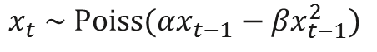
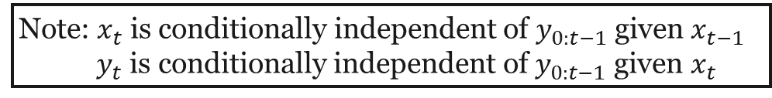
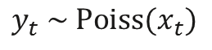
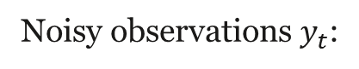
Example: stochastic logistic growth model
State $x_{t}$ representing population size at time $t$:
$$x_{t} \sim \text{Poiss}(αx_{t−1}−{βx}_{t−1}^{2})$$
Noisy observations $y_{t}$:
$$y_{t} \sim \text{Poiss}(x_{t})$$
Note: $x_{t}$ is conditionally independent of $y_{0:t−1}$ given $x_{t−1}$
$y_{t}$ is conditionally independent of $y_{0:t−1}$ given $x_{t}$
Example simulations with
initial condition $x_{0} \sim \text{Poiss}\left(10\right)$
parameters $α=1.4$, $μ=0.002$
forwardModel.m

Slide 7
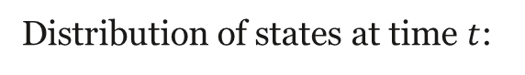
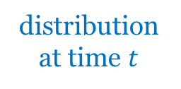
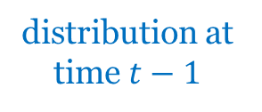
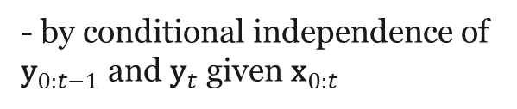
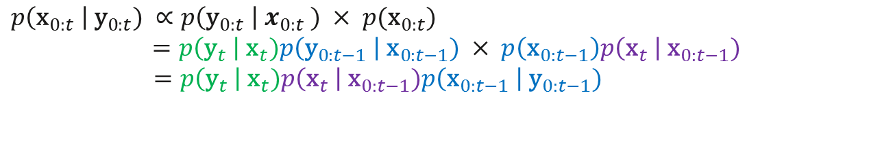
Estimation of hidden states: theory
Distribution of states at time $t$:
$$p\left({\text{x}}_{0:t} \right| {\text{y}}_{0:t}) ∝p\left({\text{y}}_{0:t} \right| x_{0:t} ) × p({\text{x}}_{0:t})$$
$$=p\left({\text{y}}_{t} \right| {\text{x}}_{t})p\left({\text{y}}_{0:t−1} \right| {\text{x}}_{0:t−1}) × p\left({\text{x}}_{0:t−1}\right)p\left({\text{x}}_{t} \right| {\text{x}}_{0:t−1})$$
$$=p\left({\text{y}}_{t} \right| {\text{x}}_{t})p\left({\text{x}}_{t} \right| {\text{x}}_{0:t−1})p\left({\text{x}}_{0:t−1} \right| {\text{y}}_{0:t−1})$$
- by conditional independence of ${\text{y}}_{0:t−1}$ and ${\text{y}}_{t}$ given ${\text{x}}_{0:t}$
This is a recursion equation on the distribution of hidden states:
distribution at time $t$
=
likelihood for observation model
×
state transition distribution
×
distribution at time $t−1$

Slide 8
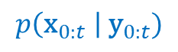
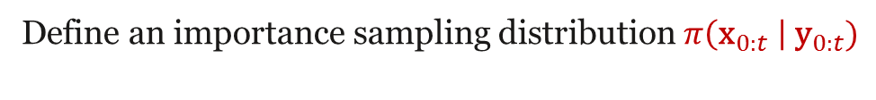
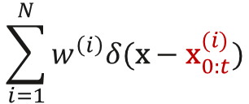
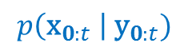
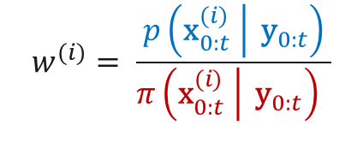
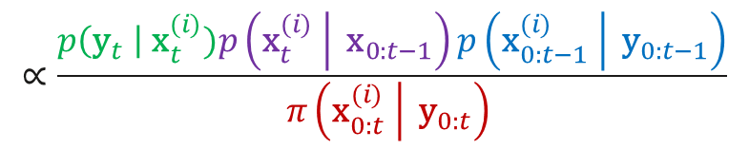
Importance sampling
Problem: it is hard to sample directly from the target distribution
$$p\left({\text{x}}_{0:t} \right| {\text{y}}_{0:t})$$
Define an importance sampling distribution $π\left({\text{x}}_{0:t} \right| {\text{y}}_{0:t})$
If we can $N$ generate samples ${\text{x}}_{0:t}^{(i)}$ from $π\left({\text{x}}_{0:t} \right| {\text{y}}_{0:t})$ and calculate weights
$$w^{(i)}= \frac{p\left.\left({\text{x}}_{0:t}^{(i)} \right| {\text{y}}_{0:t}\right)}{π\left.\left({\text{x}}_{0:t}^{(i)} \right| {\text{y}}_{0:t}\right) }$$
$$∝\frac{p\left({\text{y}}_{t} \right| {\text{x}}_{t}^{(i)})p\left.\left({\text{x}}_{t}^{(i)} \right| {\text{x}}_{0:t−1}\right)p\left.\left({\text{x}}_{0:t−1}^{(i)} \right| {\text{y}}_{0:t−1}\right)}{π\left.\left({\text{x}}_{0:t}^{(i)} \right| {\text{y}}_{0:t}\right) }$$
by the recursion equation
then the weighted samples ${\text{x}}_{0:t}^{(i)}$ represent the target distribution, i.e.
$$\sum_{i=1}^{N}{w^{\left(i\right)}δ(\text{x}−{\text{x}}_{0:t}^{(i)}})$$
is an approximation to the target density function
$$p\left({\text{x}}_{0:t} \right| {\text{y}}_{0:t})$$

Slide 9
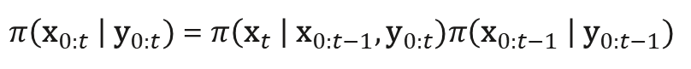
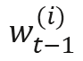
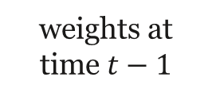
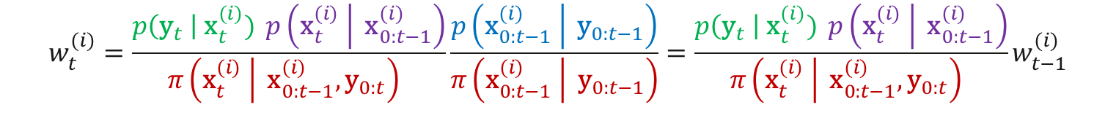
Sequential importance sampling
Define the importance distribution recursively:
$π\left({\text{x}}_{0:t} \right| {\text{y}}_{0:t})$ = $π\left({\text{x}}_{t} \right| {\text{x}}_{0:t−1}, {\text{y}}_{0:t})π\left({\text{x}}_{0:t−1} \right| {\text{y}}_{0:t−1})$
leading to weights:
$$w_{t}^{(i)}=\frac{p\left({\text{y}}_{t} \right| {\text{x}}_{t}^{(i)}) \left.p\left({\text{x}}_{t}^{(i)} \right| {\text{x}}_{0:t−1}^{(i)}\right)}{π\left.\left({\text{x}}_{t}^{(i)} \right| {\text{x}}_{0:t−1}^{(i)}, {\text{y}}_{0:t}\right) }\frac{p\left.\left({\text{x}}_{0:t−1}^{(i)} \right| {\text{y}}_{0:t−1}\right)}{π\left.\left({\text{x}}_{0:t−1}^{(i)} \right| {\text{y}}_{0:t−1}\right)}={\frac{p\left({\text{y}}_{t} \right| {\text{x}}_{t}^{(i)}) \left.p\left({\text{x}}_{t}^{(i)} \right| {\text{x}}_{0:t−1}^{(i)}\right)}{π\left.\left({\text{x}}_{t}^{(i)} \right| {\text{x}}_{0:t−1}^{(i)}, {\text{y}}_{0:t}\right) }w}_{t−1}^{(i)}$$
$$w_{t−1}^{(i)}$$
likelihood for observation model
×
state transition distribution
weights at time $t−1$
×
=
one-step importance distribution

Slide 10
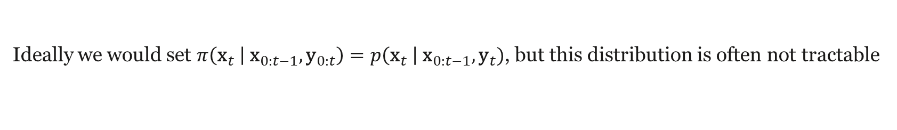
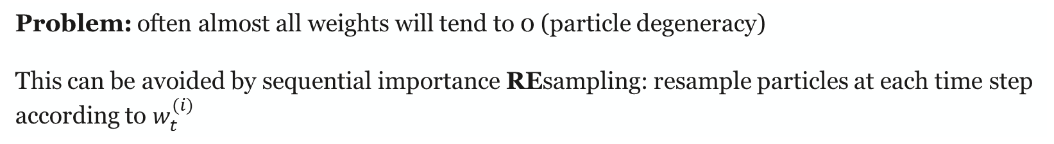
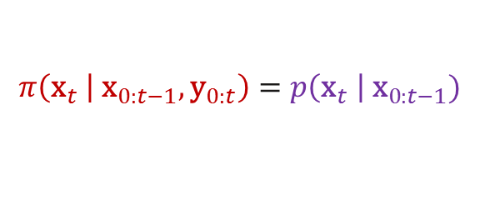
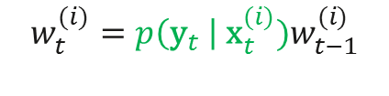
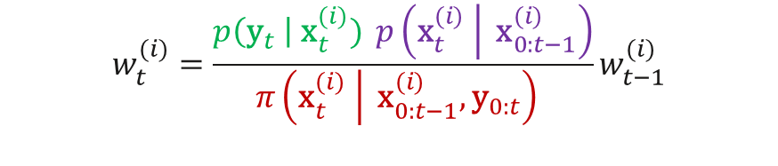
Bootstrap particle filter
$$w_{t}^{(i)}={\frac{p\left({\text{y}}_{t} \right| {\text{x}}_{t}^{(i)}) \left.p\left({\text{x}}_{t}^{(i)} \right| {\text{x}}_{0:t−1}^{(i)}\right)}{π\left.\left({\text{x}}_{t}^{(i)} \right| {\text{x}}_{0:t−1}^{(i)}, {\text{y}}_{0:t}\right) }w}_{t−1}^{(i)}$$
Ideally we would set $π\left.\left({\text{x}}_{t} \right| {\text{x}}_{0:t−1}, {\text{y}}_{0:t}\right)=p\left({\text{x}}_{t} \right| {\text{x}}_{0:t−1}, {\text{y}}_{t})$, but this distribution is often not tractable
Bootstrap filter sets
$$π\left.\left({\text{x}}_{t} \right| {\text{x}}_{0:t−1}, {\text{y}}_{0:t}\right)=p\left({\text{x}}_{t} \right| {\text{x}}_{0:t−1})$$
state transition distribution – easily simulated ☺
so the weights are:
$$w_{t}^{(i)}={p\left({\text{y}}_{t} \right| {\text{x}}_{t}^{(i)})w}_{t−1}^{(i)}$$
likelihood for observation model – easily computed ☺
Problem: often almost all weights will tend to 0 (particle degeneracy)
This can be avoided by sequential importance REsampling: resample particles at each time step according to $w_{t}^{(i)}$

Slide 11
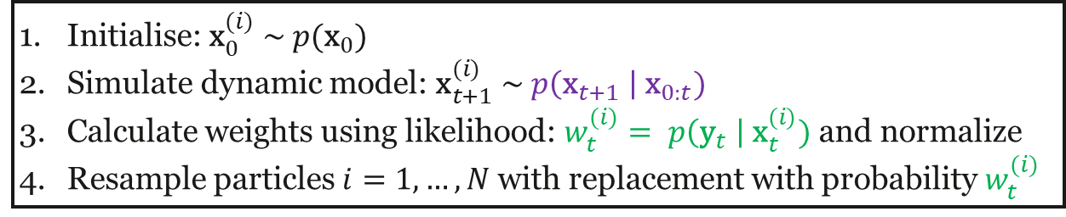
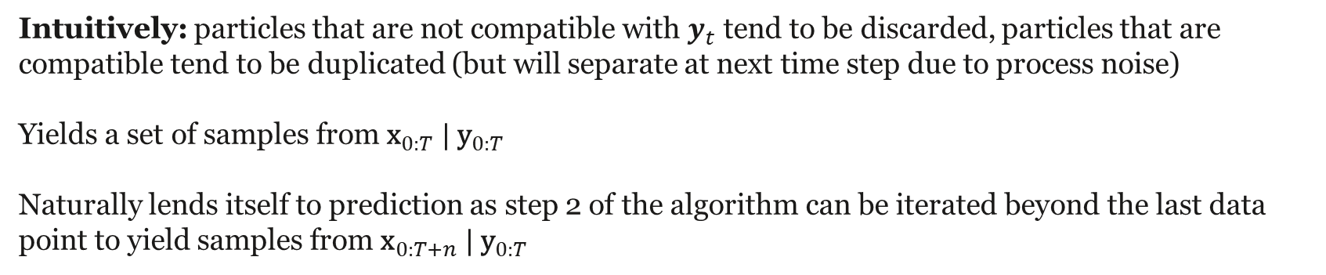
Bootstrap particle filter: algorithm
Initialise: ${\text{x}}_{0}^{(i)} \sim p({\text{x}}_{0})$
Simulate dynamic model: ${\text{x}}_{t+1}^{(i)} \sim p\left({\text{x}}_{t+1} \right| {\text{x}}_{0:t})$
Calculate weights using likelihood: $w_{t}^{(i)}= p\left({\text{y}}_{t} \right| {\text{x}}_{t}^{(i)})$ and normalize
Resample particles $i=1,…, N$ with replacement with probability $w_{t}^{(i)}$
Intuitively: particles that are not compatible with $y_{t}$ tend to be discarded, particles that are compatible tend to be duplicated (but will separate at next time step due to process noise)
Yields a set of samples from ${\text{x}}_{0:T} | {\text{y}}_{0:T}$
Naturally lends itself to prediction as step 2 of the algorithm can be iterated beyond the last data point to yield samples from ${\text{x}}_{0:T+n} | {\text{y}}_{0:T}$

Slide 12


Example: estimating hidden states
State $x_{t}$ representing population size at time $t$:
$$x_{t} \sim \text{Poiss}(αx_{t−1}−{βx}_{t−1}^{2})$$
Noisy observations $y_{t}$:
$$y_{t} \sim \text{Poiss}(x_{t})$$
estStates_stepped.m
Example with
initial condition $x_{0} \sim \text{Poiss}\left(10\right)$
parameters $α=$1.4, $β=0.002$
estStates.m

Slide 13



Parameter estimation: state augmentation
Now targeting
$$p\left({\text{x}}_{0:T} , \text{θ} \right| {\text{y}}_{0:T})= \frac{p\left({\text{y}}_{0:T} \right| {\text{x}}_{0:T}, \text{θ})p({\text{x}}_{0:T}, \text{θ})}{p({\text{y}}_{0:T})}$$
Method 1: state augmentation
Treat $\text{θ}$ as additional states so that the dynamic model becomes:
$${\text{θ}}_{t}= {\text{θ}}_{t−1}$$
$${\text{x}}_{t} \sim p\left({\text{x}}_{t} \right| {\text{x}}_{0:t−1}, {\text{θ}}_{t−1})$$
Problem: the pruning of particles based on the likelihood means the sample of $\text{θ} \text{tends} \text{to} \text{become} \text{degenerate}$
Can get around this with random parameter perturbation:
$${\text{θ}}_{t}= {\text{θ}}_{t−1}+{\text{ε}}_{t−1}$$
$${\text{x}}_{t} \sim p\left({\text{x}}_{t} \right| {\text{x}}_{0:t−1}, {\text{θ}}_{t−1})$$
which can work well if having a (slowly) time-varying parameter makes sense for your model

Slide 14


Example: jointly estimating hidden states and parameters
State $x_{t}$ representing population size at time $t$:
$$x_{t} \sim \text{Poiss}(αx_{t−1}−{βx}_{t−1}^{2})$$
Noisy observations $y_{t}$:
$$y_{t} \sim \text{Poiss}(x_{t})$$
Example with
initial condition $x_{0} \sim \text{Poiss}\left(10\right)$
parameters $α=$1.4, $β=0.002$
estStatesAndParams.m

Slide 15

Parameter estimation: MCMC
Method 2: particle marginal Metropolis-Hastings algorithm
Andrieu et al (2010), JRSS B
An approximate likelihood function for $θ$ can be obtained by averaging the (unnormalized) weights $w_{t}^{(i)}$ and taking the product over all time steps $t$:
$$L\left(θ\right)=\prod_{t=1}^{T}{\left(\frac{1}{N}\sum_{i=1}^{N}{w_{t}^{(i)}}\right)}$$
This likelihood function can be output by the bootstrap filter algorithm with no additional overhead, and used in a standard MCMC routine.

Slide 16



Application to epidemic reproduction number estimation
Simplest case: Poisson observation noise, new infections observed immediately
Hidden states: instantaneous reproduction number
$$R_{t} \sim \text{N}\left(R_{t−1},σ_{R}\right)$$
$$I_{t} \sim \text{Poiss}\left(R_{t}\sum_{s=1}^{m}{I_{t−s}g_{s}}\right)$$
$$y_{t}\sim \text{Poiss}(I_{t})$$
- Gaussian random walk*
number of new infections on day $t$
- Poisson renewal equation
Observed state: number of new infections on day $t$
probability mass function for generation interval
*or choose your favourite prior

Slide 17



Example: NZ Covid-19 in Feb-May 2020
$$σ_{R}=0.2$$
$R_{0} \sim Γ\left(μ=2,σ=1\right)$
$g_{s}\sim$ $Γ\left(μ=5,σ=2\right)$
epiExample.m

Slide 18



Reproduction number estimation
More realistic version: each infection is observed with probability $α$and there is a delay from time of infection to time of notification.
Hidden states: instantaneous reproduction number
$$R_{t} \sim \text{N}\left(R_{t−1},σ\right)$$
$$I_{t} \sim \text{Poiss}\left(R_{t}\sum_{s=1}^{m}{I_{t−s}g_{s}}\right)$$
$$Z_{t}=\sum_{s=1}^{m}{I_{t−s}h_{s}}$$
$$y_{t} \sim \text{Poiss}\left({αZ}_{t}\right)$$
- Gaussian random walk
number of new infections on day $t$
- Poisson renewal equation
number of infections by notification date
Observed state: number of new infections on day $t$
probability mass function for time from infection to notification

Slide 19


Particle history degradation
$$t=0$$
$$t=1$$

Slide 20
Particle history degradation
$$t=0$$
$$t=1$$

Slide 21

Particle history degradation
$$t=0$$
$$t=1$$
$$t=2$$

Slide 22
Particle history degradation
$$t=0$$
$$t=1$$
$$t=2$$

Slide 23

Particle history degradation
$$t=0$$
$$t=1$$
$$t=2$$
$$t=3$$

Slide 24

Particle history degradation
$$t=0$$
$$t=1$$
$$t=2$$
$$t=3$$
Problem: Fewer and fewer unique particles as you look further back in time from the present step
Fixed-lag resampling: instead of resampling entire particle history ${\text{x}}_{1:t}$, just resample the most recent $L$ steps ${\text{x}}_{t−L:t}$
OK so long as dynamic model for ${\text{x}}_{t+1}$ only depends on ${\text{x}}_{t−L:t}$
Means that (for $t<T−L$) you only get marginal posterior for each ${\text{x}}_{t}$ rather than the joint posterior for ${\text{x}}_{1:T}$

Slide 25


SARS-CoV-2 wastewater surveillance data

Slide 26













Hidden state model
hidden states
observations
Hidden states:
reproduction number $R_{t}$
case ascertainment ratio $ρ_{t}$
new infections $I_{t}$
$$\left(R_{t} \right| R_{t−1}) \sim N\left(R_{t−1}, σ_{R}\right)$$
- Gaussian RWs
$$R_{t}$$
$$I_{t}$$
$$W_{t}$$
$$\left(ρ_{t} \right| ρ_{t−1}) \sim N\left(ρ_{t−1}, σ_{ρ}\right)$$
$$\left(I_{t} \right| I_{1:t−1},R_{t−1}) \sim Poiss\left(R_{t}\sum_{s}{I_{t−s}g_{s}}\right)$$
$$ρ_{t}$$
$$C_{t}$$
infection to reporting distribution
Observed states:
reported cases $C_{t}$
$$\left(C_{t} \right| I_{t},ρ_{t}) \sim NegBin\left(μ=ρ_{t}\sum_{s}{I_{t−s}v_{s}}, k_{c}\right)$$
wastewater $W_{t}$
$$\left(W_{t} \right| I_{t}) \sim Gamma\left(μ=c_{g}\sum_{s}{I_{t−s}w_{s}}, k_{w}\right)$$
mean genome copies per infection
infection to shedding distribution
Watson et al. (2024) Communications Medicine, https://doi.org/10.1038/s43856-024-00570-3

Slide 27

Results

Slide 28

Watson et al. (2024) Jointly estimating epidemiological dynamics of Covid-19 from case and wastewater data in Aotearoa New Zealand, https://doi.org/10.1038/s43856-024-00570-3

Slide 29

Particle filtering methods: pros & cons
Pros:
Flexible – can use on a wide variety of data-generating models, including
nonlinear, non-Markovian dynamics
non-Gaussian noise
continuous/discrete variables.
Conceptually simple, easy to implement.
Data is assimilated recursively giving updated estimates as new observations are made.
Uncertainty can be propagated forwards to give prediction distributions.
Cons:
Can fail if the support of (samples from) the importance distribution don’t contain the target distribution.
Can require a large number of particles if the importance distribution is not well matched to the target.
E.g. if hidden states at time $t$ are strongly correlated with observations at time $t+n$ for large $n$.
Sampling from the full distribution $x_{0:T} | y_{0:T}$ becomes more challenging as the number of time points $T$ increases (but OK if dynamics are not strongly history-dependent & you only want ${\text{x}}_{T−n:T} | {\text{y}}_{0:T}$ for relatively small $n$)

Slide 30


Want to know more?
Presentation and Matlab code:
https://github.com/michaelplanknz/MATRIX2024-particle-filters

